Slide 1
Notes:
From 2012-2013 I was in China on a Fulbright grant studying rural utility vehicles. I sought to understand how they were being retrofitted to function in cities instead of rural areas – like this three-wheeled vehicle, which has been turned into a mobile noodle shop. This meant visiting a lot of cities and their markets.

Slide 2
Notes:
Researching across the world’s most populous country, I got to know some of China’s 260 million migrant laborers, equal to the population of the world’s ten largest cities combined. Driven seekers of economic opportunity, these migrants were nearly always in or headed towards a city.

Slide 3
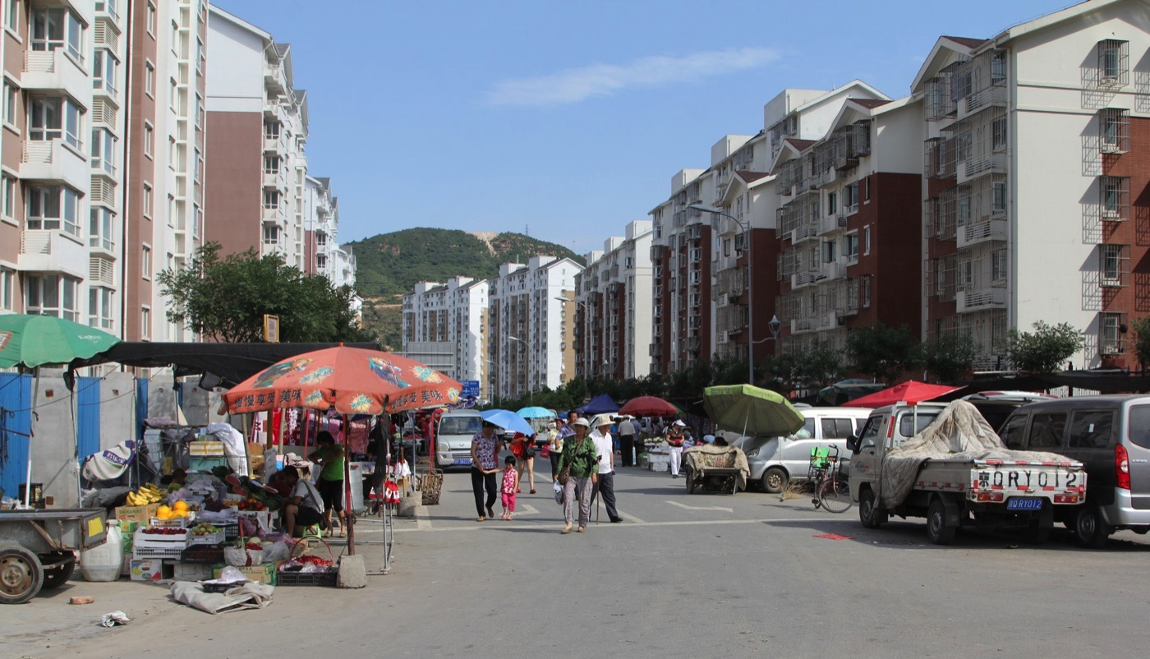
Notes:
Besides these willing migrants, many rural-dwellers today are being uprooted and forced by the government into communities like this one on the outskirts of Beijing - isolated from public transport, far from both the urban center and the fields of their villages, here oftentimes the only functioning economy is informal.

Slide 4
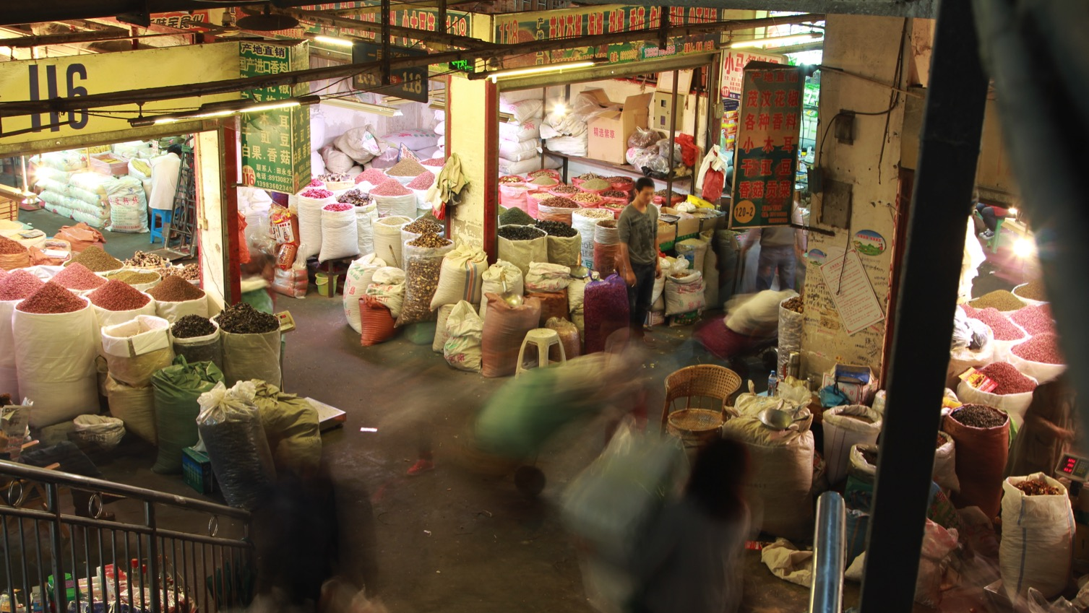
Notes:
As both willing and unwilling migrants flood into cities, one of the last traces of China’s rural past vanishes from them: urban markets, like this one in Chongqing that once formed the center of Chinese economic and social life, are being demolished or moved outside of the city to make room for more profitable land uses.

Slide 5
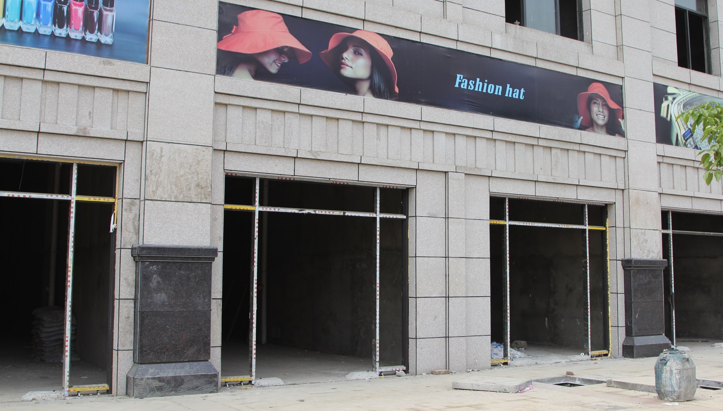
Notes:
This element of China’s drive to “modernize” is stretching the environmental and social fabric to its limits. Like America in the mid-20th century, malls are replacing local markets, but here many are built speculatively and remain unfinished like this one.

Slide 6
Notes:
Without traditional markets in which to legally sell, some migrants try informal street selling, or dì tān in Chinese. “Dì”, the left character, means ground, while “tān” means to spread out. Here, the “ground” happens be 40 feet up in the air on a highway’s pedestrian overpass.

Slide 7
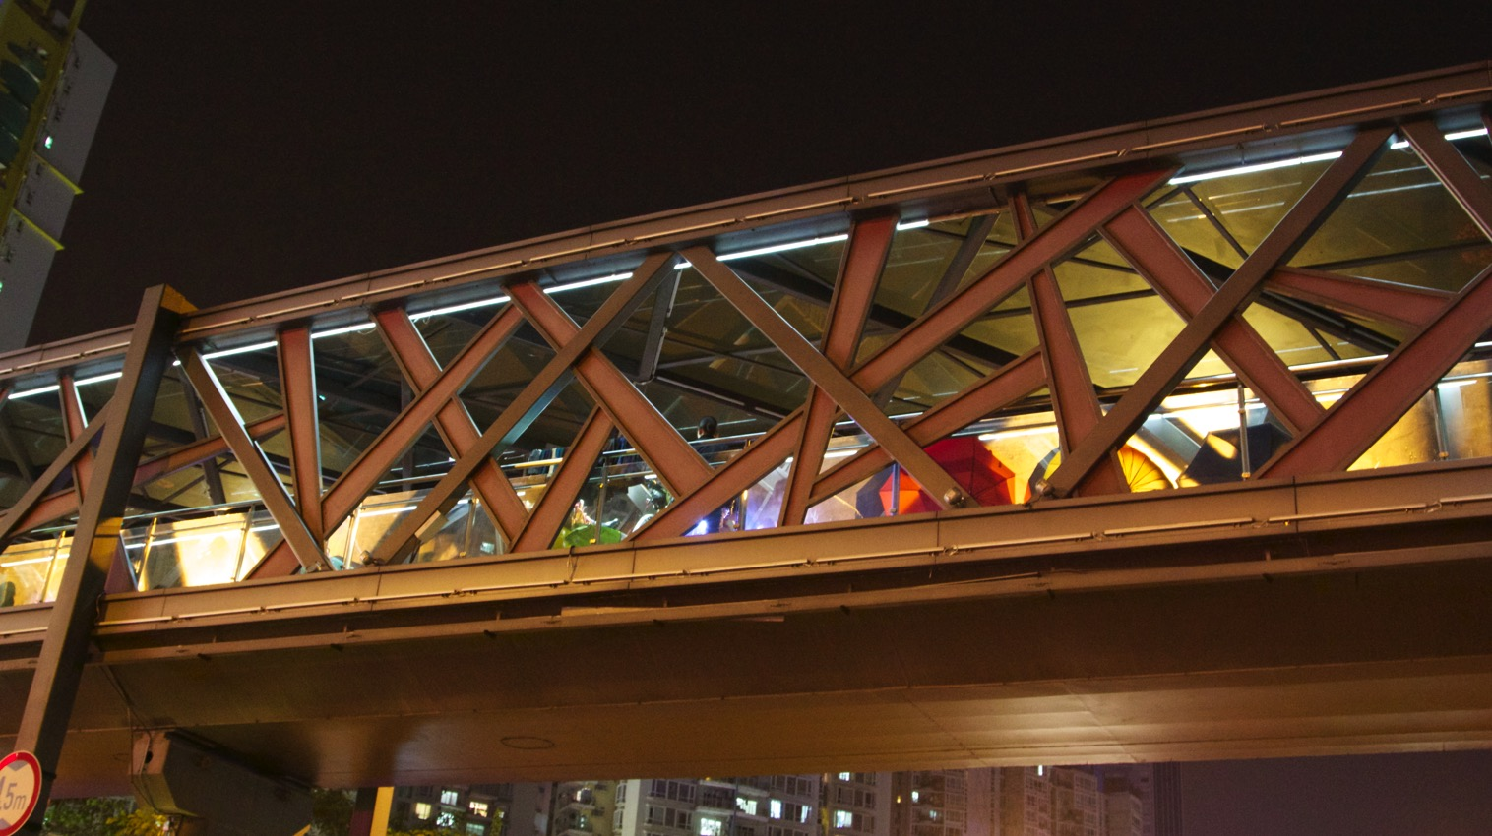
Notes:
“Why on top of a pedestrian overpass?”, you may ask. Fair question. Skyrocketing car ownership has lead to pedestrian convenience being sacrificed for smoother vehicle traffic, creating a proliferation of pedestrian passageways above and beneath China’s city streets, such as this one in Shenzhen.

Slide 8
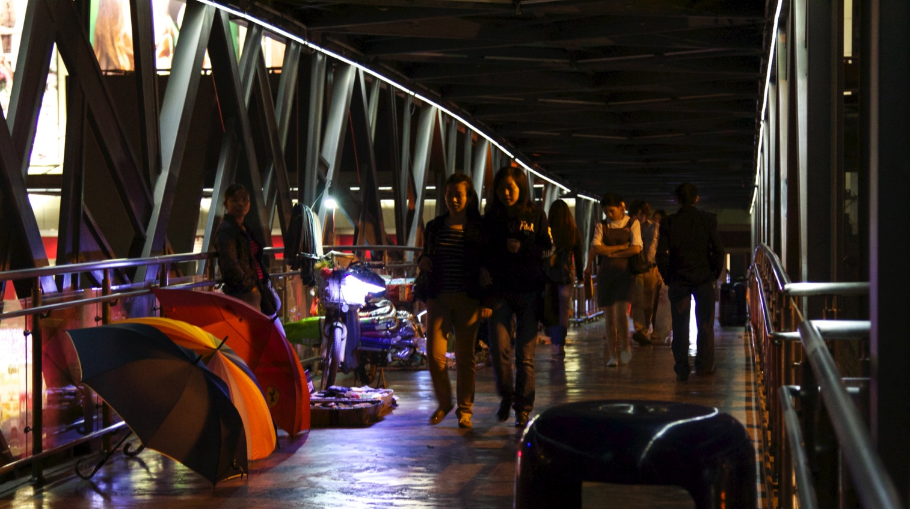
Notes:
That sterilized exterior conceals a vibrant inner life. These liminal "non-spaces" are being transformed into a new type of urban place, as limited spatial and employment opportunities combine with resource-constrained ingenuity to create thriving new marketplaces.

Slide 9
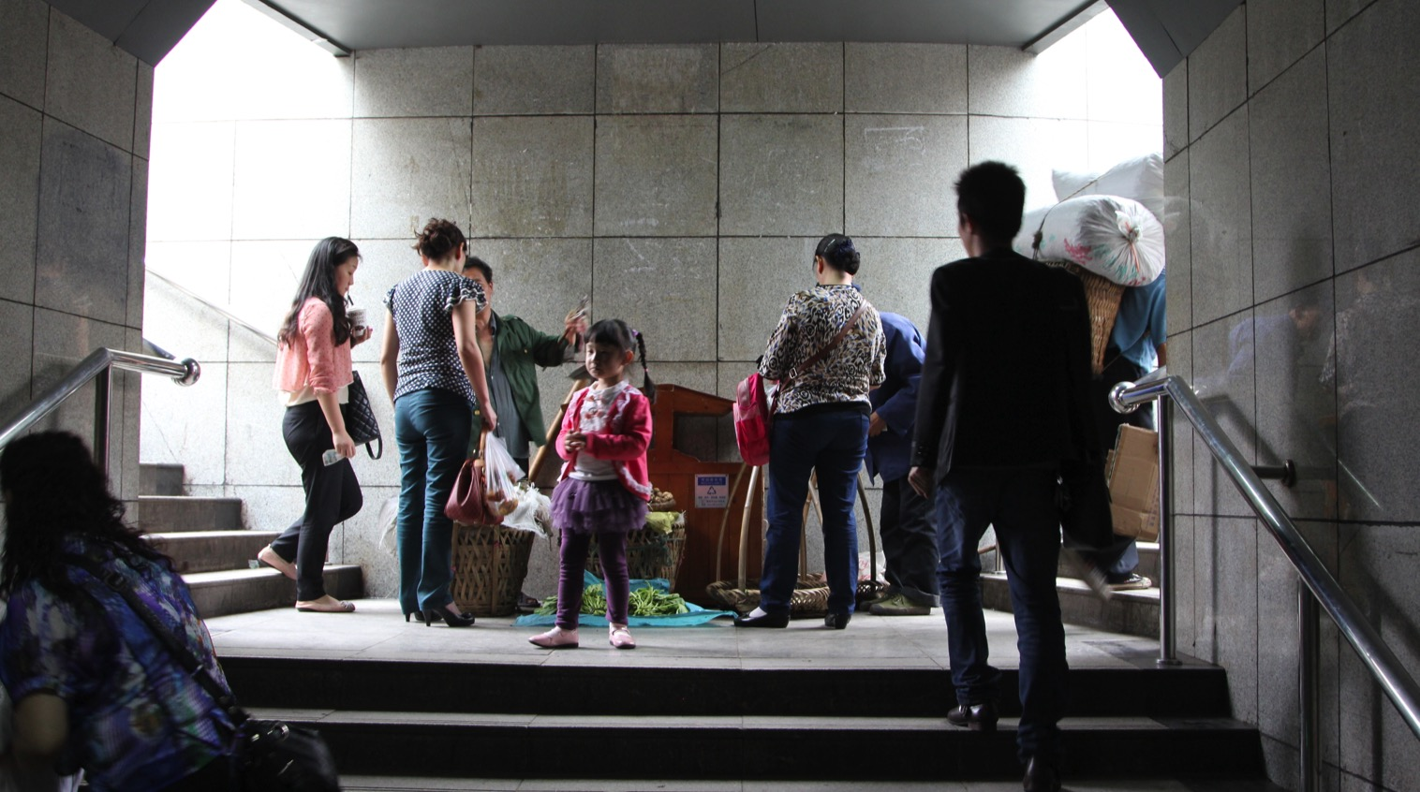
Notes:
The constant surge of humanity coursing through them recalls traditional markets, attracting construction workers, office staff, tourists, retirees, students, and more. However, unlike yesterday’s markets, these new commercial forums are no longer destinations, but rather waypoints on the way to elsewhere.

Slide 10
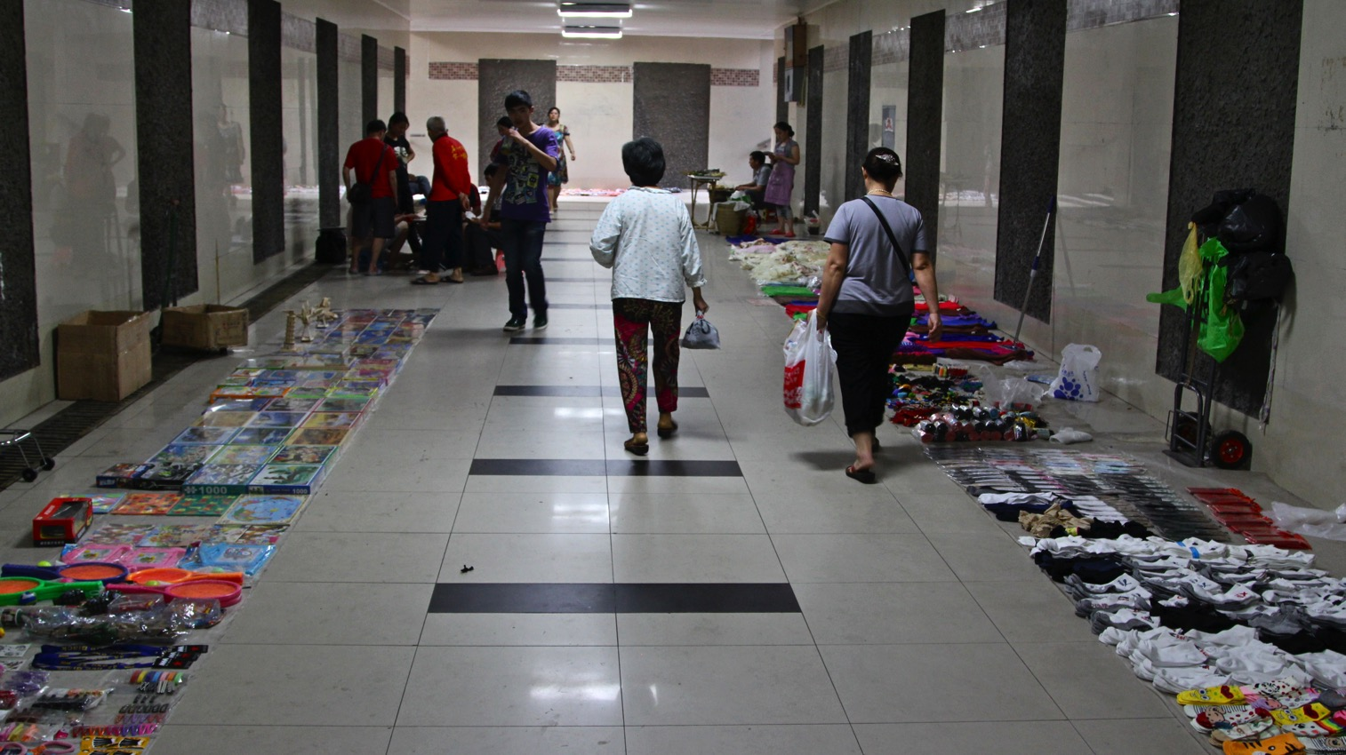
Notes:
The variety of available goods is overwhelming: phone cases, books, paintings, posters, toys, small pieces of clothing like socks and underwear, CD’s and DVD’s, all manner of home décor, and basically any kind of small consumer good imaginable, from mouse traps to moisturizer, from fake nails to nail clippers.

Slide 11
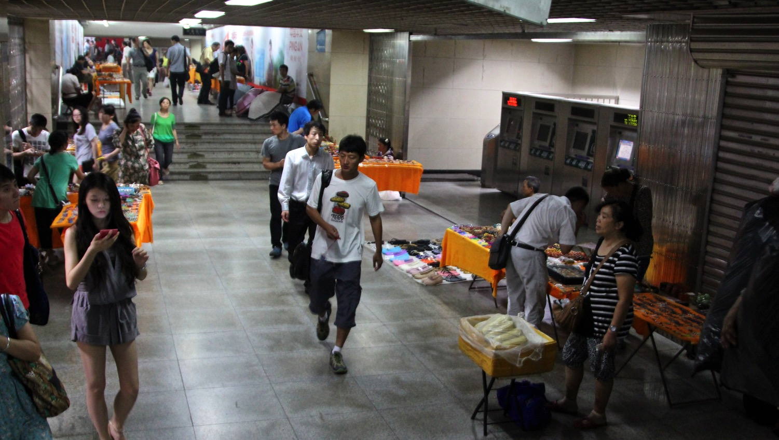
Notes:
Some of these markets offer shelter from the elements as well. Vendors in this air-conditioned subway station in Beijing stock items that add convenience to customers’ journeys at this transition point, such as snacks, maps, sunglasses, hats, handheld fans, umbrellas and raincoats.

Slide 12
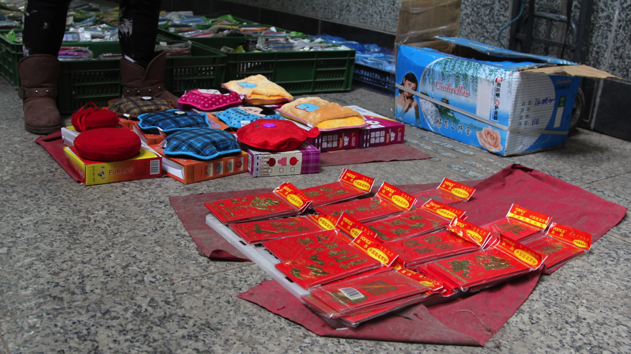
Notes:
As inventory space is highly limited, it must be closely calibrated to the moment’s consumer demands. As the seasons change, t-shirts and handheld fans are replaced by battery-powered hand-warmers, and the red envelopes with which money is presented to children during China’s wintertime Lunar New Year celebrations.

Slide 13
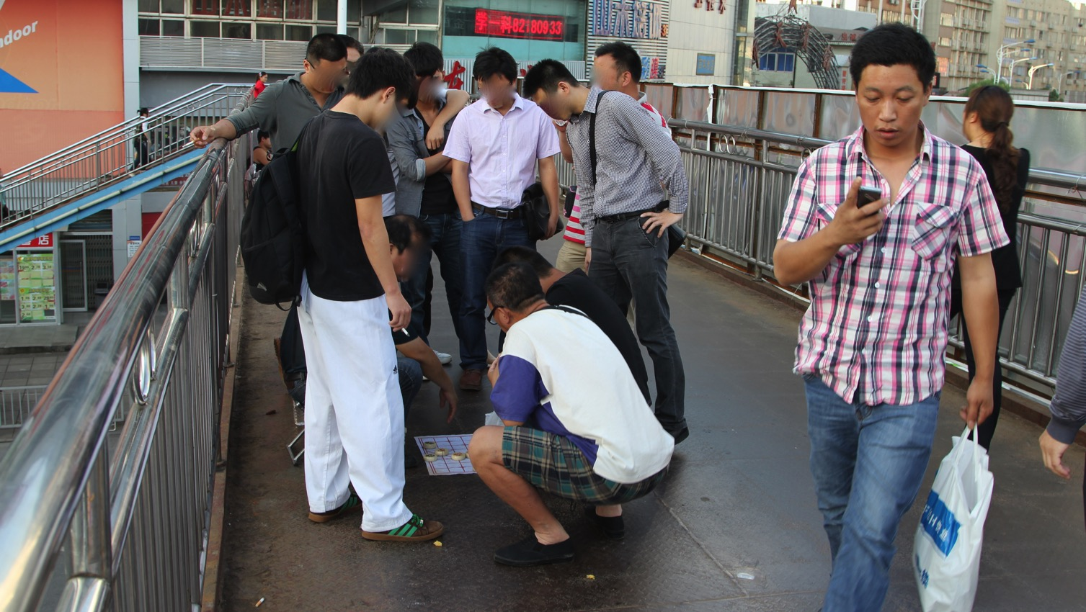
Notes:
Indeed, these spaces are not just for retail activities, either. The presence of gambling in and around some of these markets frees a particular local business from the associated risks of hosting the gamblers, instead relegating it to this “legally flexible” space owned by noone.

Slide 14
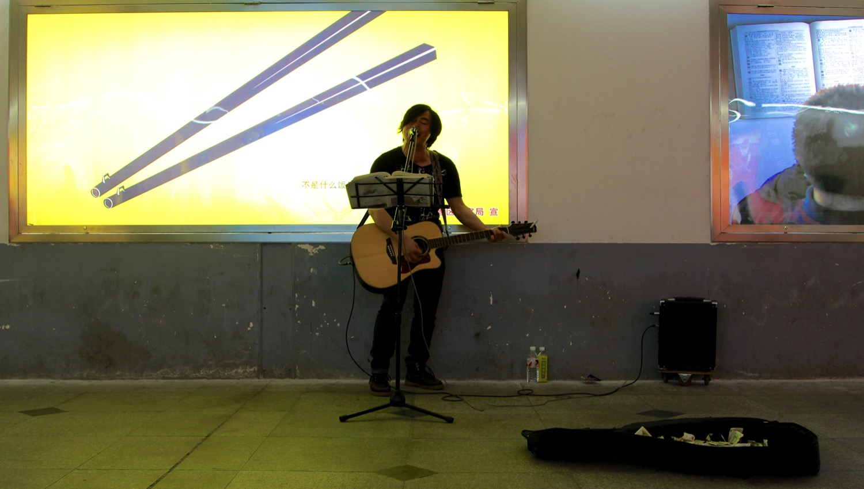
Notes:
These spaces also provide opportunity for public performance - from oldsters playing an èrhú, the mournful-sounding two-stringed traditional instrument, to the crooning of an impassioned solo guitarist, here with a portable amplifier he’s plugged into this underpass’s wall.

Slide 15
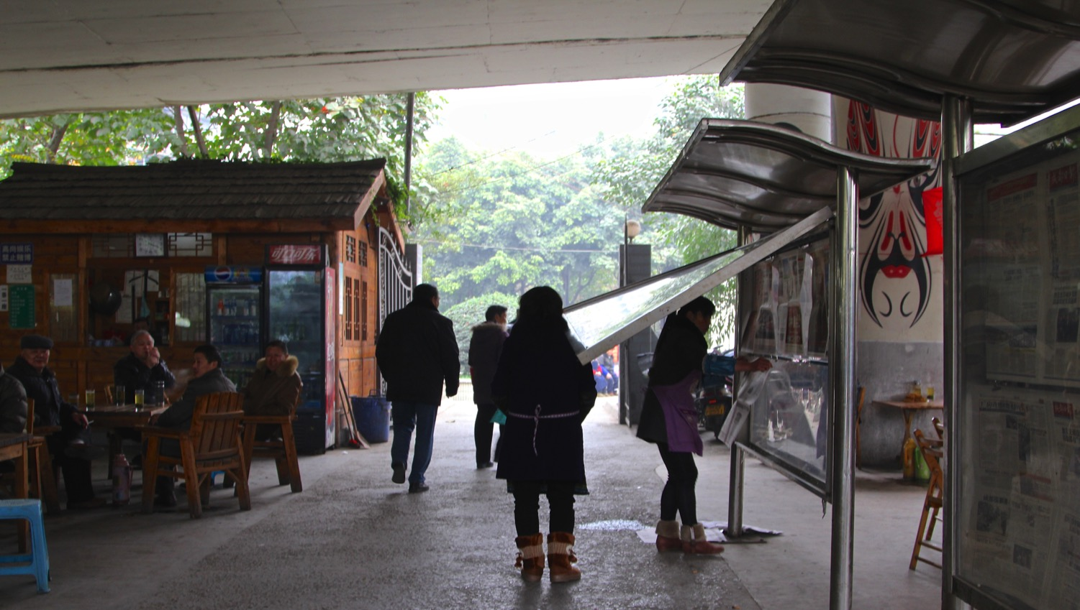
Notes:
Of course, it isn’t always the chance of hitting the jackpot, or even the lure of bargain nail clippers that draw people to these spaces – it can be as simple as the desire for human interaction, as with the retirees who frequently meet at this teashop in a highway underpass to catch up on news and gossip.

Slide 16
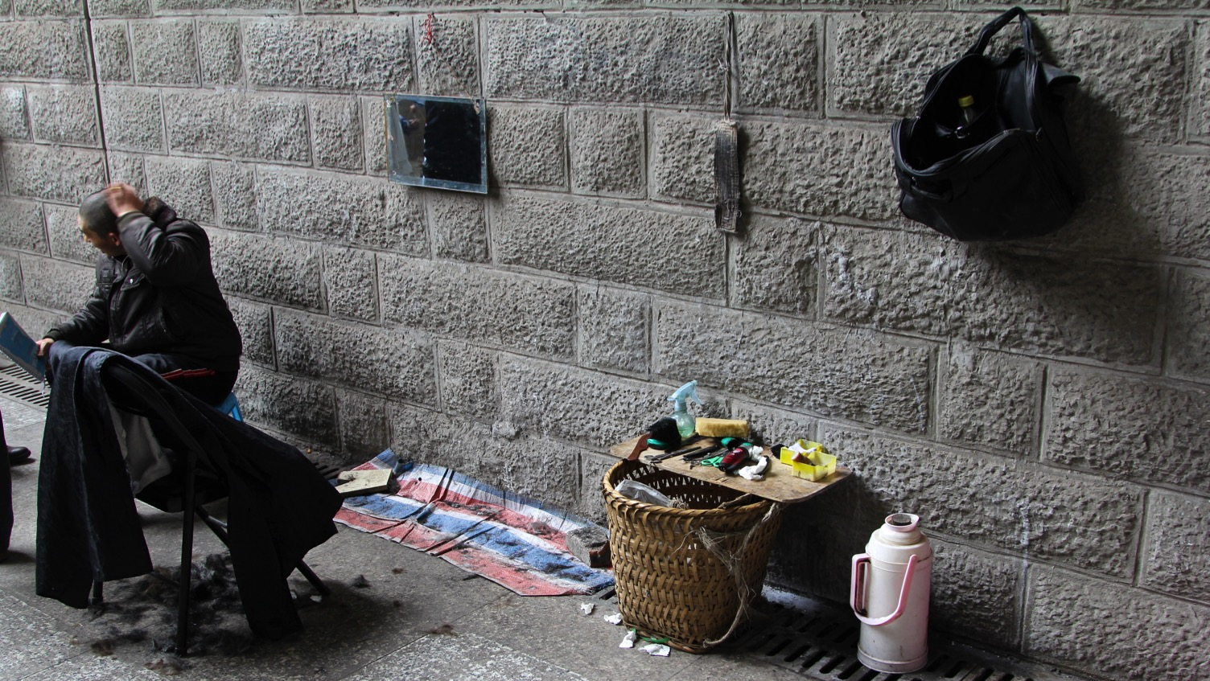
Notes:
A hot cup of oolong is just one of many services available. This underpass-based barber used to be a migrant laborer, but now says his body is too tired for such work. He explains that storefronts are too expensive to rent, and he gets chased away from cutting hair elsewhere, so setting up in this underpass is his only option.

Slide 17
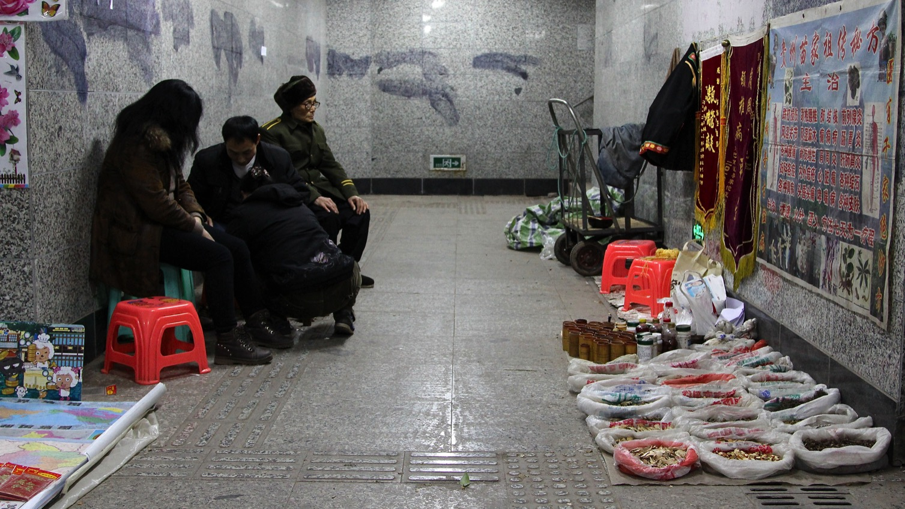
Notes:
These markets host services even more vital to life as well. Five years ago, after her previous pharmacy was demolished, this Chinese medicine doctor relocated her practice to this underpass. Now, many in the community, especially the elderly and lower-income migrants, rely upon her underground clinic.

Slide 18
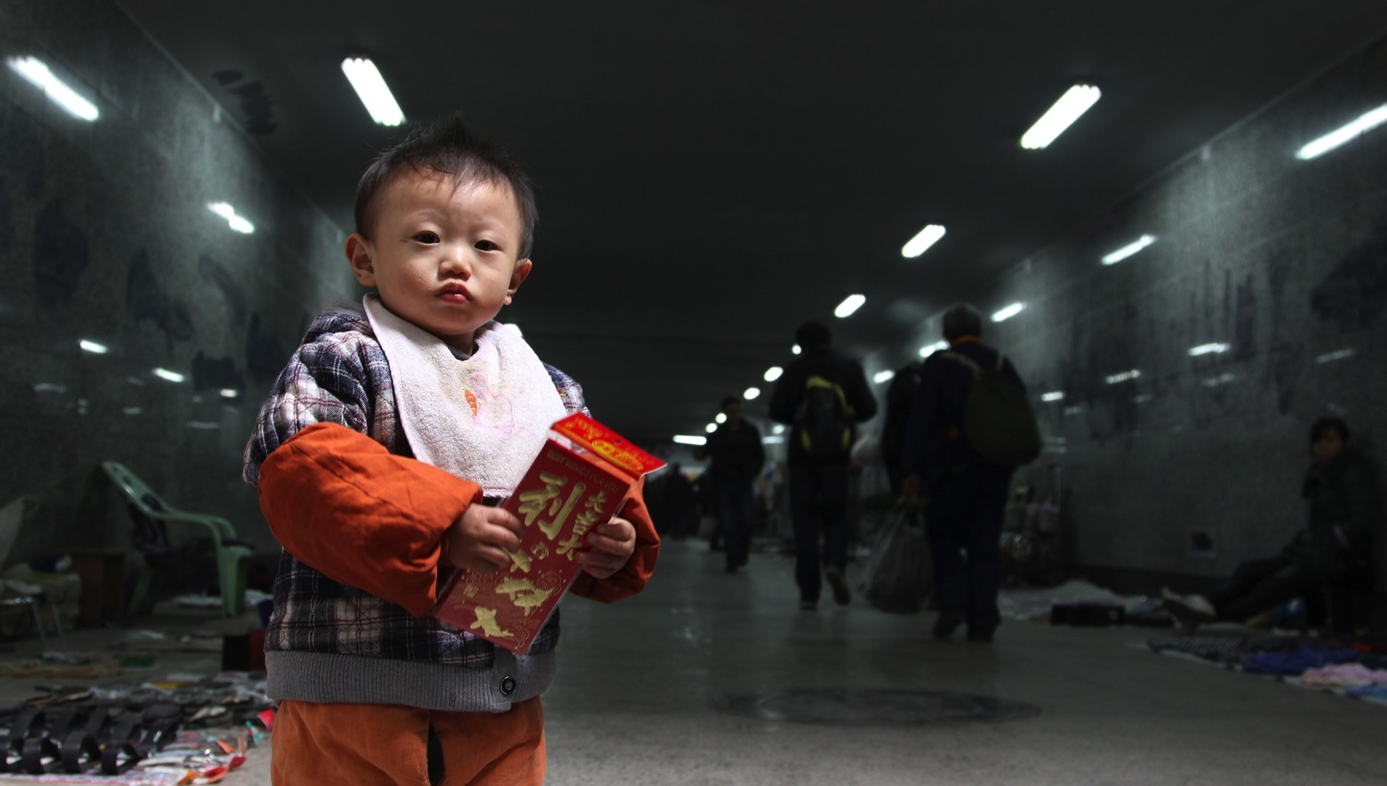
Notes:
These markets are also social pressure valves. While his parents work as laborers in a faraway province, this child is being raised by his elderly grandparents, who must sell in this underpass to survive. The grandparents lack social safety nets like a pension, making this their only available childcare option.

Slide 19
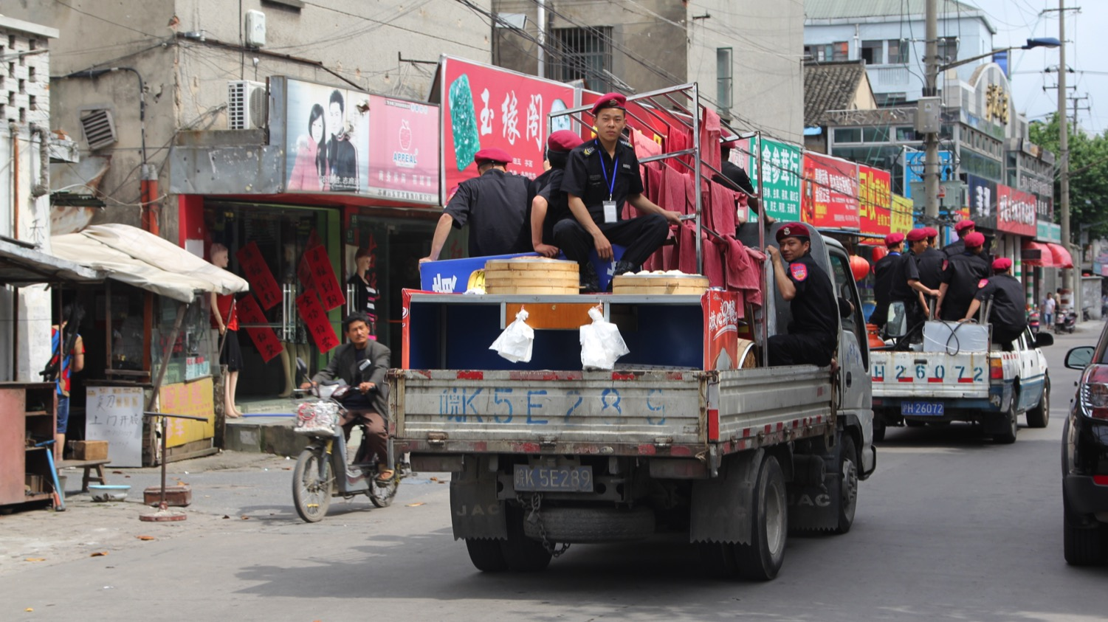
Notes:
Here is the main threat to these markets: the “urban management” teams, whose job is to ensure city sidewalks are kept “orderly”, means that they routinely harass vendors, confiscate their merchandise, beat and sometimes even kill them. Despite this danger, these vendors remain.

Slide 20
Notes:
I argue that by targeting these spaces, Chinese cities risk destroying more than just a place for cheap goods and services – they threaten a space for livelihoods for the less fortunate, an absorber of unskilled migrant labor, a space for performance and leisure, and a model for how traditional and modern can co-exist. Thank you.

Slide 21
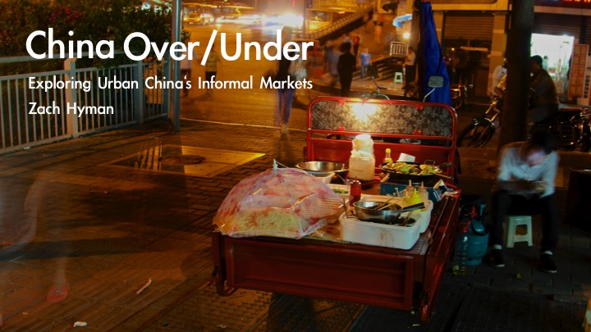
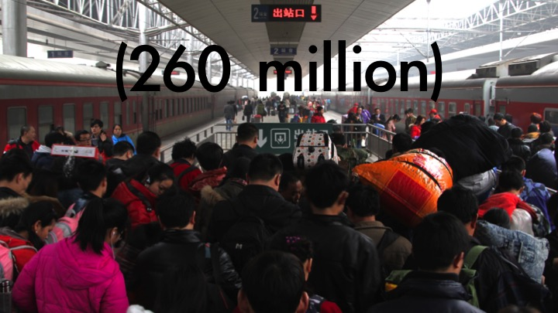
Presented at: Ethnographic Praxis in
Industry Conference // September 2014
Pecha Kucha (20 slides • 20 secs each)
01
From 2012-2013 I was in China on a Fulbright grant studying
rural utility vehicles. I sought to understand how they were
being retrofitted to function in cities instead of rural areas – like
this three-wheeled vehicle, which has been turned into a mobile
noodle shop. This meant visiting a lot of cities and their markets.
02
Researching across the world’s most populous country, I got to
know some of China’s 260 million migrant laborers, equal to the
population of the world’s ten largest cities combined. Driven
seekers of economic opportunity, these migrants were nearly
always in or headed towards a city.

Slide 22
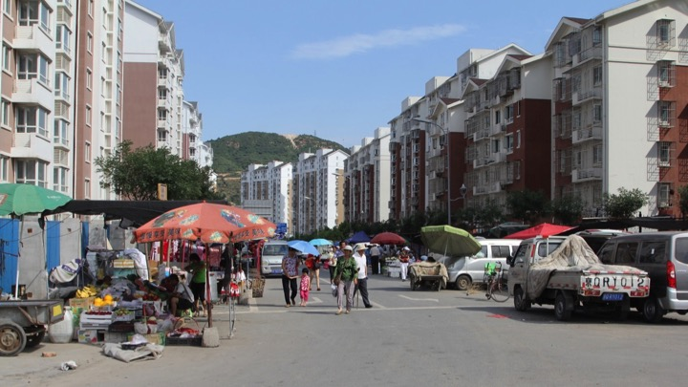
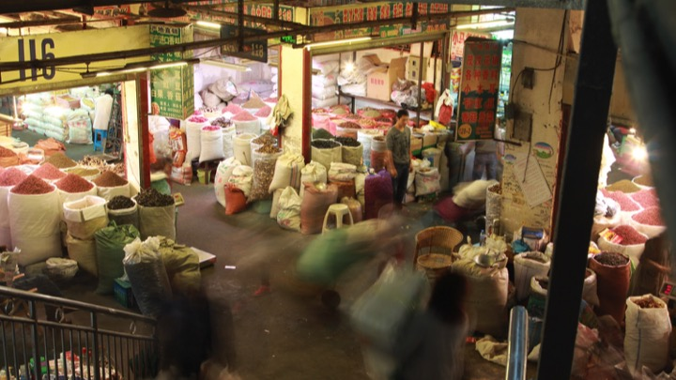

03
Besides these willing migrants, many rural-dwellers today are
being uprooted and forced by the government into communities
like this one on the outskirts of Beijing - isolated from public
transport, far from both the urban center and the fields of their
villages, here often the only functioning economy is informal.
04
As both willing and unwilling migrants flood into cities, one of the
last traces of China’s rural past vanishes from them: urban
markets, like this one in Chongqing that once formed the center
of Chinese economic and social life, are being demolished or
moved out of the city to make room for more profitable land uses.
05
This element of China’s drive to “modernize” is stretching the
environmental and social fabric to its limits. Like America in the
mid-20th century, malls are replacing local markets, but here
many are built speculatively and remain unfinished like this one.

Slide 23
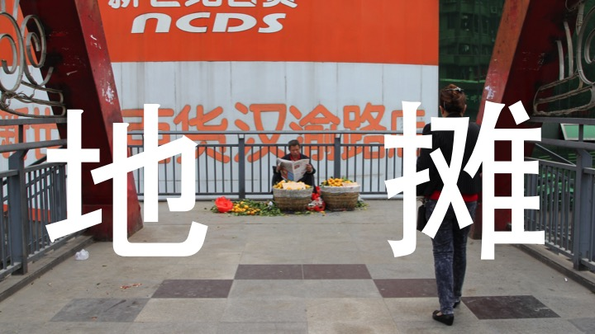
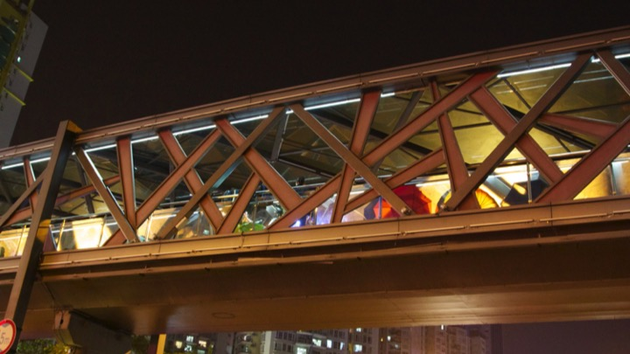

06
Without traditional markets in which to legally sell, some
migrants try informal street selling, or dì tān in Chinese. “Dì”,
the left character, means ground, while “tān” means to spread
out. Here, the “ground” happens be 40 feet up in the air on a
highway’s pedestrian overpass.
07
“Why on top of a pedestrian overpass?”, you may ask. Fair
question. Skyrocketing car ownership has lead to pedestrian
convenience being sacrificed for smoother vehicle traffic,
creating a proliferation of pedestrian passageways above and
beneath China’s city streets, such as this one in Shenzhen.
08
That sterilized exterior conceals a vibrant inner life. These
liminal "non-spaces" are being transformed into a new type of
urban place, as limited spatial and employment opportunities
combine with resource-constrained ingenuity to create thriving
new marketplaces.

Slide 24
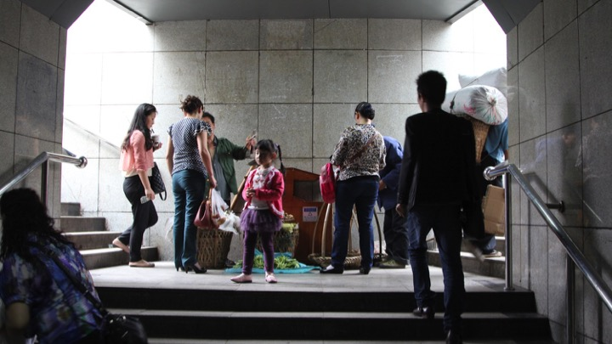
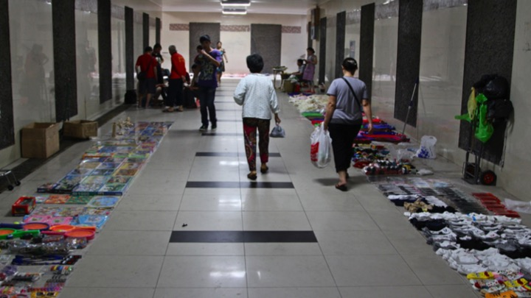
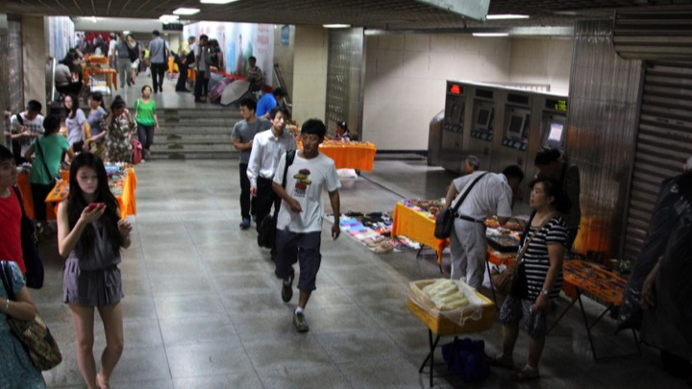
09
The constant surge of humanity coursing through them recalls
traditional markets, attracting construction workers, office staff,
tourists, retirees, students, and more. However, unlike
yesterday’s markets, these new commercial forums are no
longer destinations, but waypoints on the way to elsewhere.
10
The variety of available goods is overwhelming: phone cases,
books, paintings, posters, toys, small pieces of clothing like
socks and underwear, CD’s and DVD’s, all manner of home
décor, and any kind of small consumer good imaginable, from
mouse traps to moisturizer, from fake nails to nail clippers.
11
Some of these markets offer shelter from the elements as well.
Vendors in this air-conditioned subway station in Beijing stock
items that add convenience to customers’ journeys at this
transition point, such as snacks, maps, sunglasses, hats,
handheld fans, umbrellas and raincoats.

Slide 25

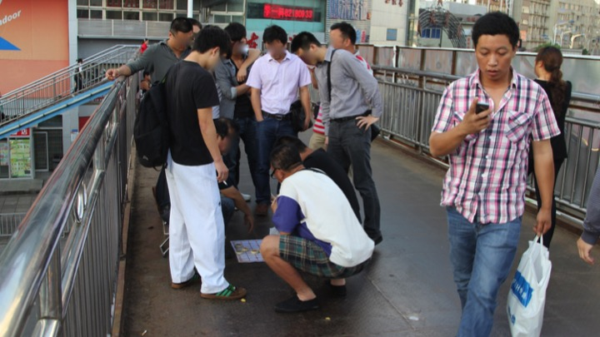
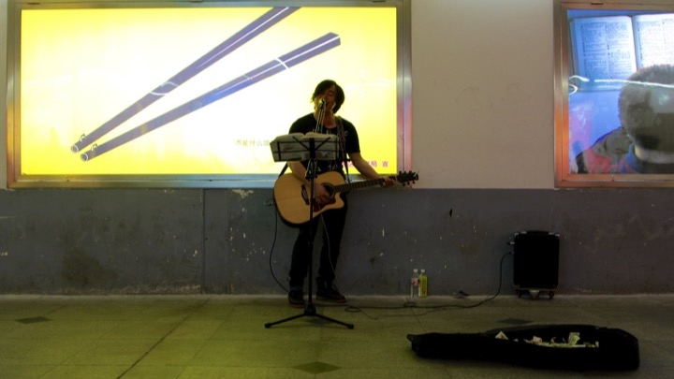
12
As inventory space is highly limited, it must be closely calibrated
to the consumer demands. As the seasons change, t-shirts and
handheld fans are replaced by battery-powered hand-warmers,
and the red envelopes with which money is presented to
children during China’s wintertime Lunar New Year celebrations.
13
Indeed, these spaces are not just for retail activities, either. The
presence of gambling in and around some of these markets
frees a particular local business from the associated risks of
hosting the gamblers, instead relegating it to this “legally
flexible” space owned by noone.
14
These spaces also provide opportunity for public performance –
from oldsters playing an èrhú, the mournful-sounding
two-stringed traditional instrument, to the crooning of an
impassioned solo guitarist, here with a portable amplifier he’s
plugged into this underpass’s wall.

Slide 26

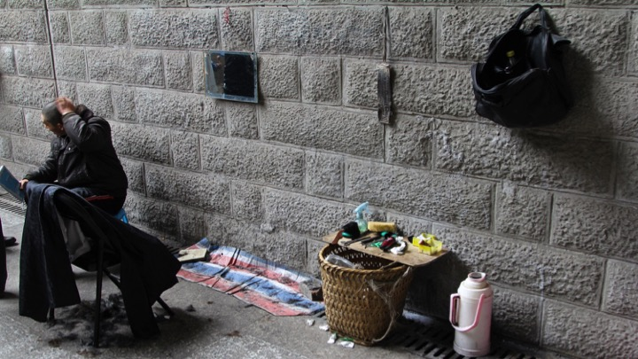
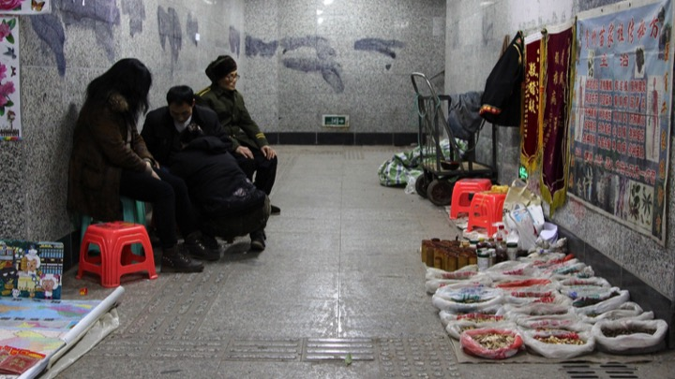
15
Of course, it isn’t always the chance of hitting the jackpot, or
even the lure of bargain nail clippers that draw people to these
spaces – it can be as simple as the desire for human interaction,
as with the retirees who frequently meet at this teashop in a
highway underpass to catch up on news and gossip.
16
A hot cup of oolong is just one of many services available. This
underpass-based barber used to be a migrant laborer, but now
says his body is too tired for such work. He says that storefronts
are too expensive, and he gets chased away from cutting hair
elsewhere, so setting up in this underpass is his only option.
17
These markets host services even more vital to life as well. Five
years ago, after her previous pharmacy was demolished, this
Chinese medicine doctor relocated her practice to this
underpass. Now, many in the community, especially the elderly
and lower-income migrants, rely upon her underground clinic.

Slide 27
18
These markets are also social pressure valves. While his parents
work as laborers in a faraway province, this child is being raised
by his elderly grandparents, who must sell in this underpass to
survive. The grandparents lack social safety nets like a pension,
making this their only available childcare option.
19
Here is the main threat to these markets: the “urban
management” teams, whose job is to ensure city sidewalks are
kept “orderly”, means that they routinely harass vendors,
confiscate their merchandise, beat and sometimes even kill
them. Despite this danger, these vendors remain.
20
By targeting these spaces, Chinese cities risk destroying more
than just a place for cheap goods and services; they threaten a
space for livelihoods for the less fortunate, an absorber of
unskilled migrant labor, space for performance and leisure, and
a model for how traditional and modern can co-exist. Thank you.

